Slide 1
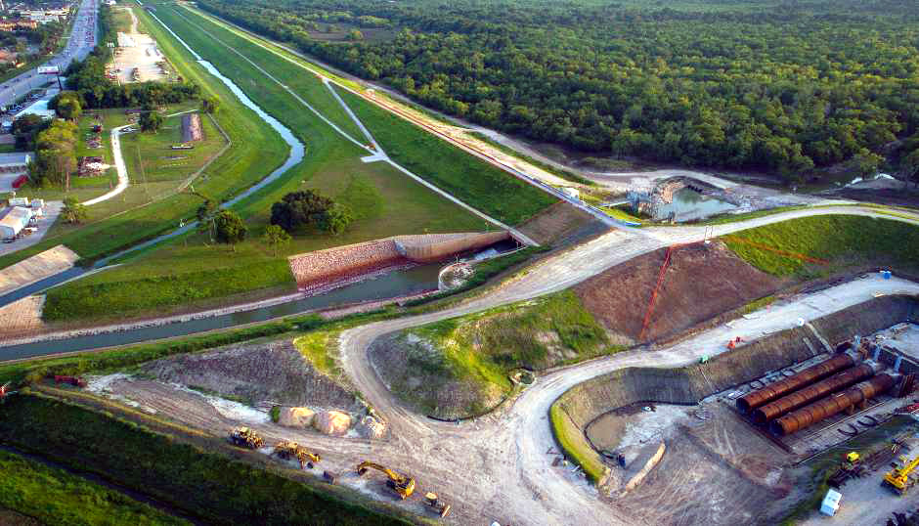
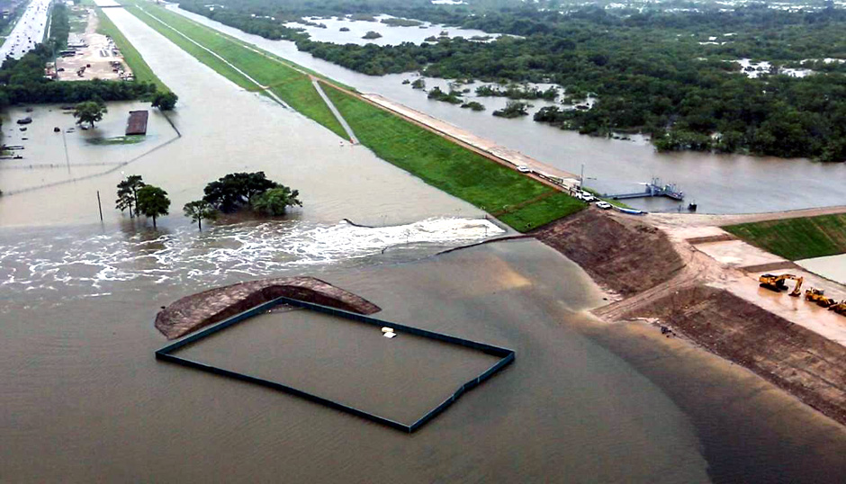
Upstream Flood Risk Reduction for Next Harvey
January 23, 2019
Data Science Project 1
Rice University - Houston, Texas
Lesly Bohuchot
Doug Newsom
Margret Saniel

Slide 2
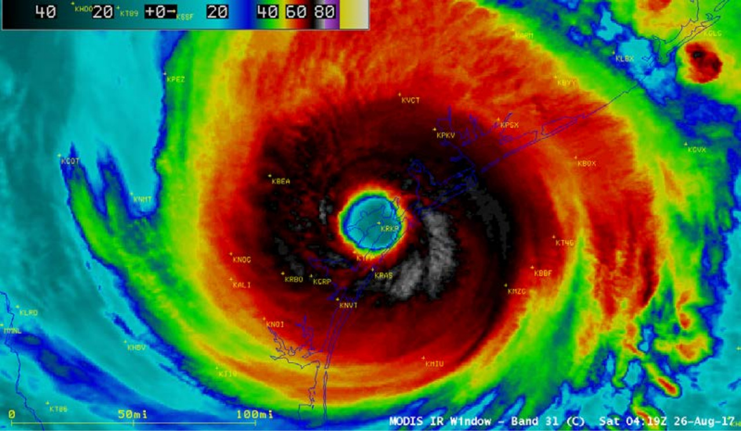

Slide 3
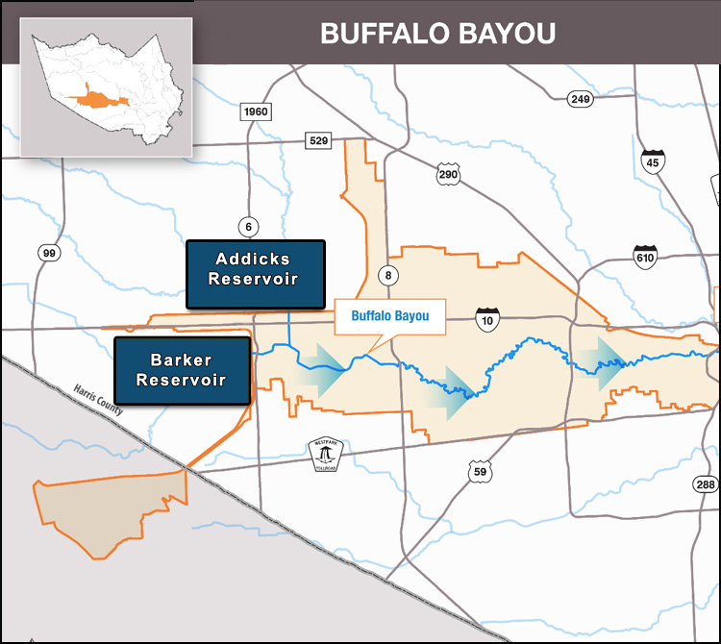
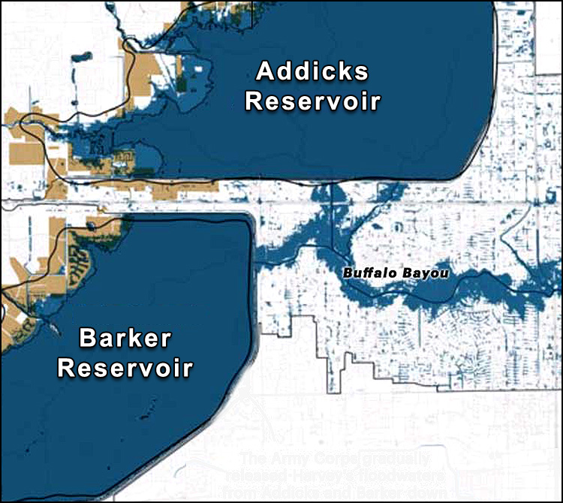
Buffalo Bayou Study Area

Slide 4
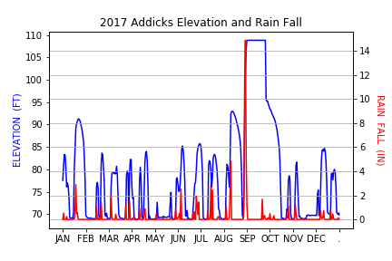
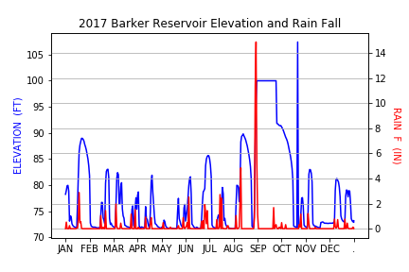
Reservoir Flooding

Slide 5
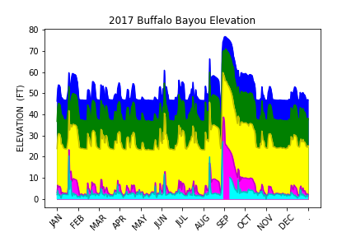
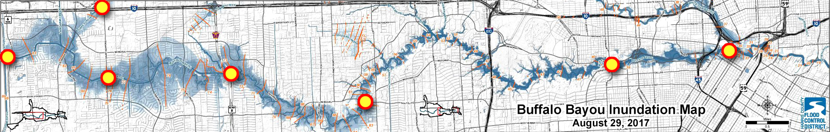
Buffalo Bayou Flood Monitoring

Slide 6
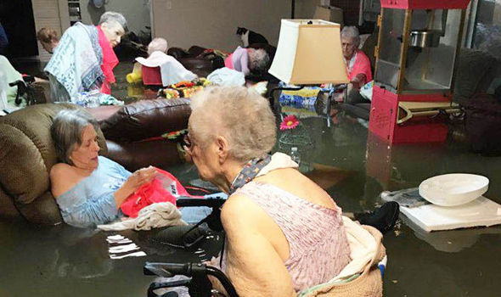
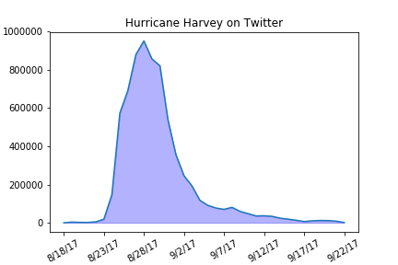
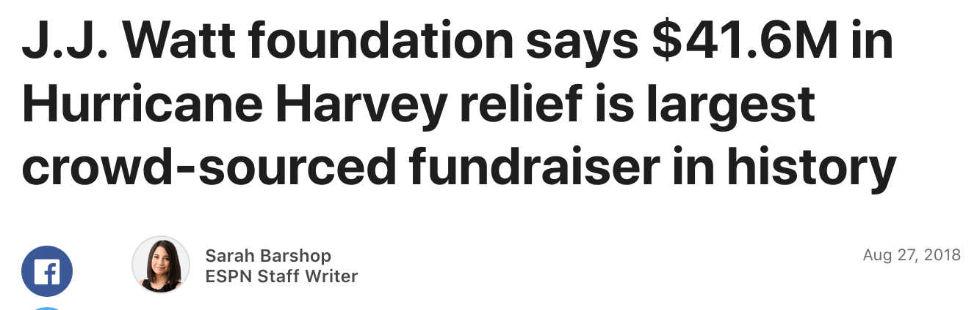
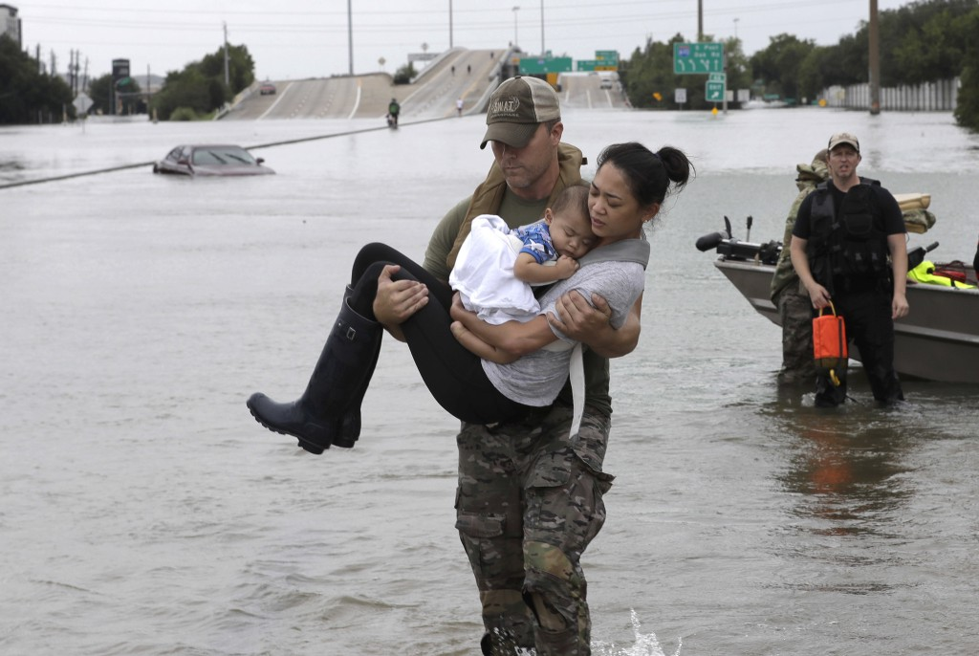
Hurricane Harvey on Social Media

Slide 7
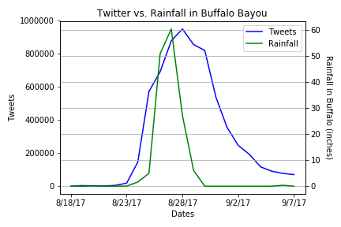
Buffalo Bayou and Twitter
Peak rainfall = 60.36 in
7M tweets total during Harvey

Slide 8
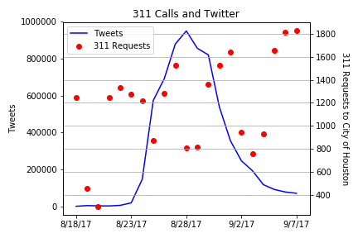
Service Requests and Social Media
50k requests sent in
+700 requests still open to date

Slide 9
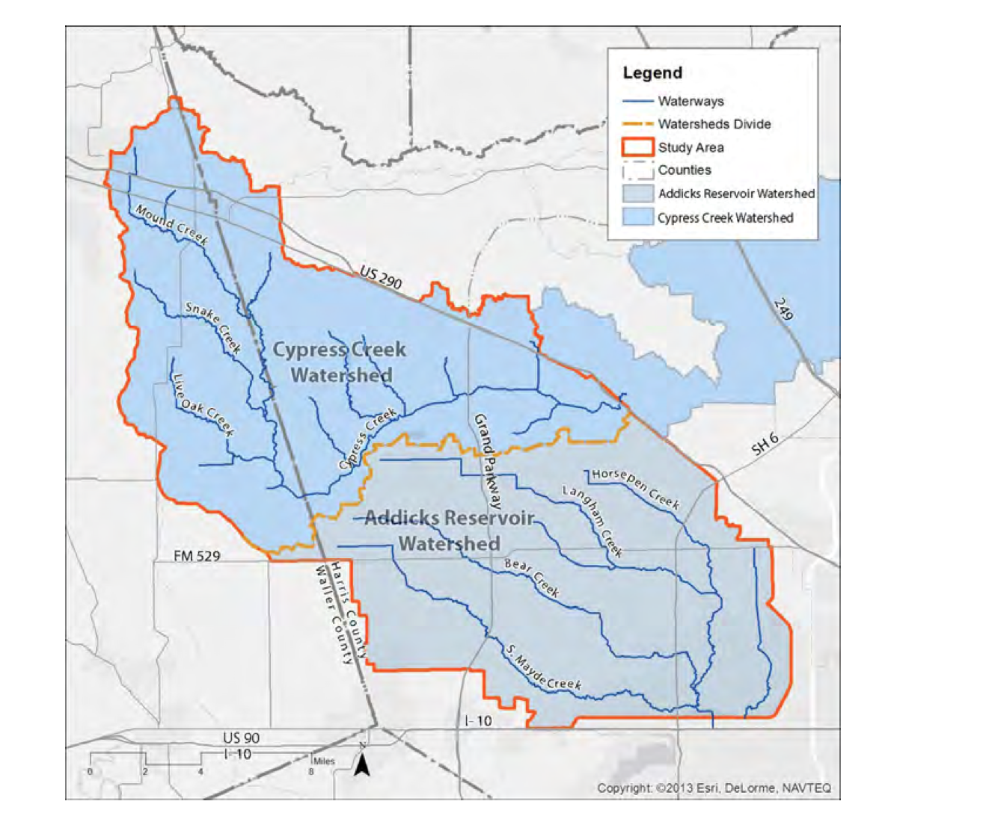
3rd reservoir Cypress Creek Watershed

Slide 10
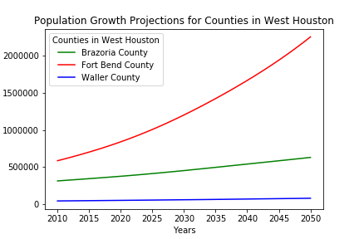
Population Growth Projection

Slide 11
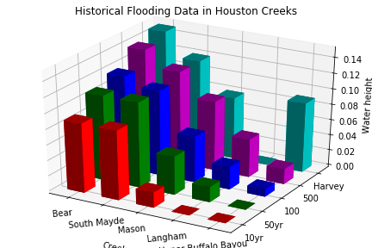
Flood Risk Probability

Slide 12
Conclusions
Addicks and Barker Reservoirs: Constant Threat
Future Buffalo Bayou Flooding: High Risk
Social Media: Platform for Breaking News
COH Service Requests Delayed Five Days
West Houston High Population Growth Expected
Need To Protect West Incoming Communities

